Slide 1
Raw SQL queries
Django basic to pro in Nepali

Slide 2
Performing raw SQL queries
Django gives you two ways of performing raw SQL queries: you can use Manager.raw() to perform raw
queries and return model instances, or you can avoid the model layer entirely and execute custom SQL directly.
Performing raw queries
The raw() manager method can be used to perform raw SQL queries that return model instances:
Manager.raw(raw_query, params=(), translations=None)
This method takes a raw SQL query, executes it, and returns a django.db.models.query.RawQuerySet instance. This RawQuerySet instance can be iterated over like a normal QuerySet to provide object instances.
This is best illustrated with an example. Suppose you have the following model:
class Person(models.Model):
first_name = models.CharField(...)
last_name = models.CharField(...)
birth_date = models.DateField(...)
You could then execute custom SQL like so:
>>> for p in Person.objects.raw("SELECT * FROM myapp_person"):
... print(p)
...
John Smith
Jane Jones
This example isn’t very exciting – it’s exactly the same as running Person.objects.all(). However, raw()
has a bunch of other options that make it very powerful.

Slide 3
Model table names
Where did the name of the Person table come from in that example?
By default, Django figures out a database table name by joining the model’s “app label” – the name you used in manage.py startapp – to the model’s class name, with an underscore between them. In the example we’ve assumed that the Person model lives in an app named myapp, so its table would be myapp_person.
Warning: No checking is done on the SQL statement that is passed in to .raw(). Django expects that the statement will return a set of rows from the database but does nothing to enforce that. If the query does not return rows, a (possibly cryptic) error will result.
Warning: If you are performing queries on MySQL, note that MySQL’s silent type coercion may cause unexpected results when mixing types. If you query on a string type column, but with an integer value, MySQL will coerce the types of all values in the table to an integer before performing the comparison. For example, if your table contains the values 'abc', 'def' and you query for WHERE mycolumn=0, both rows will match. To prevent this, perform the correct typecasting before using the value in a query.
Mapping query fields to model fields
raw() automatically maps fields in the query to fields on the model.
The order of fields in your query doesn’t matter. In other words, both of the following queries work identically:
>>> Person.objects.raw("SELECT id, first_name, last_name, birth_date FROM myapp_person")
>>> Person.objects.raw("SELECT last_name, birth_date, first_name, id FROM myapp_person")
Matching is done by name. This means that you can use SQL’s AS clauses to map fields in the query to model
fields. So if you had some other table that had Person data in it, you could easily map it into Person instances:

Slide 4
>>> Person.objects.raw(
... """
... SELECT first AS first_name,
... last AS last_name,
... bd AS birth_date,
... pk AS id,
... FROM some_other_table
... """
... )
If the names match, the model instances will be created correctly.
Index lookups
raw() supports indexing, so if you need only the first result you can write:
>>> first_person = Person.objects.raw("SELECT * FROM myapp_person")[0]
However, the indexing and slicing are not performed at the database level. If you have many Person objects in your database, it is more efficient to limit the query at the SQL level:
>>> first_person = Person.objects.raw("SELECT * FROM myapp_person LIMIT 1")[0]
Alternatively, you can map fields in the query to model fields using the translations argument to raw(). This is a dictionary mapping names of fields in the query to names of fields on the model. For example, the above query could also be written:
>>> name_map = {"first": "first_name", "last": "last_name", "bd": "birth_date", "pk": "id"}
>>> Person.objects.raw("SELECT * FROM some_other_table", translations=name_map)

Slide 5
Deferring model fields
Fields may also be left out:
>>> people = Person.objects.raw("SELECT id, first_name FROM myapp_person")
The Person objects returned by this query will be deferred model instances (see defer()). This means that the fields that are omitted from the query will be loaded on demand. For example:
>>> for p in Person.objects.raw("SELECT id, first_name FROM myapp_person"):
... print(
... p.first_name, # This will be retrieved by the original query
... p.last_name, # This will be retrieved on demand
... )
...
John Smith
Jane Jones
From outward appearances, this looks like the query has retrieved both the first name and last name. However, this example issued 3 queries. Only the first names were retrieved by the raw() query – the last names were both retrieved on demand when they were printed. There is only one field that you can’t leave out - the primary key field. Django uses the primary key to identify model instances, so it must always be included in a raw query. A FieldDoesNotExist exception will be raised if you forget to include the primary key.

Slide 6
Adding annotations
You can also execute queries containing fields that aren’t defined on the model. For example, we could use PostgreSQL’s age() function to get a list of people with their ages calculated by the database:
>>> people = Person.objects.raw("SELECT *, age(birth_date) AS age FROM myapp_person")
>>> for p in people:
... print("%s is %s." % (p.first_name, p.age))
...
John is 37.
Jane is 42.
...
You can often avoid using raw SQL to compute annotations by instead using a Func() expression.
Passing parameters into raw()
If you need to perform parameterized queries, you can use the params argument to raw():
>>> lname = "Doe"
>>> Person.objects.raw("SELECT * FROM myapp_person WHERE last_name = %s", [lname])
params is a list or dictionary of parameters. You’ll use %s placeholders in the query string for a list, or %(key)s placeholders for a dictionary (where key is replaced by a dictionary key), regardless of your database engine.
Such placeholders will be replaced with parameters from the params argument.
Note: Dictionary params are not supported with the SQLite backend; with this
backend, you must pass parameters as a list.

Slide 7
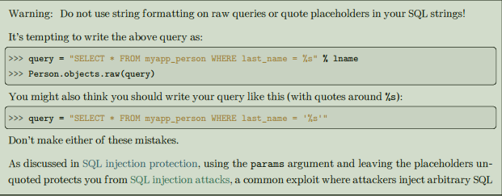

Slide 8
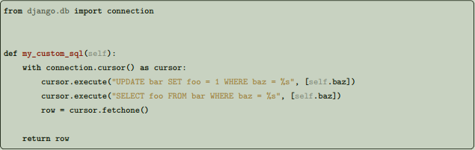
Executing custom SQL directly
Sometimes even Manager.raw() isn’t quite enough: you might need to perform queries that don’t map cleanly to models, or directly execute UPDATE, INSERT, or DELETE queries. In these cases, you can always access the database directly, routing around the model layer entirely. The object django.db.connection represents the default database connection. To use the database connection, call connection.cursor() to get a cursor object. Then, call cursor.execute(sql, [params]) to execute the SQL and cursor.fetchone() or cursor.fetchall() to return the resulting rows.
For example:

Slide 9
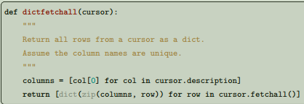
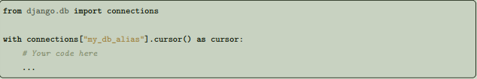
To protect against SQL injection, you must not include quotes around the %s placeholders in the SQL string. Note that if you want to include literal percent signs in the query, you have to double them in the case you are passing parameters:
cursor.execute("SELECT foo FROM bar WHERE baz = '30%'")
cursor.execute("SELECT foo FROM bar WHERE baz = '30%%' AND id = %s", [self.id])
If you are using more than one database, you can use django.db.connections to obtain the connection (and cursor) for a specific database. django.db.connections is a dictionary-like object that allows you to retrieve a specific connection using its alias:
By default, the Python DB API will return results without their field names, which means you end up with a list of values, rather than a dict. At a small performance and memory cost, you can return results as a dict by using something like this:
Another option is to use collections.namedtuple() from the Python standard library. A namedtuple is a tuple-like object that has fields accessible by attribute lookup; it’s also indexable and iterable. Results are immutable and accessible by field names or indices, which might be useful:

Slide 10
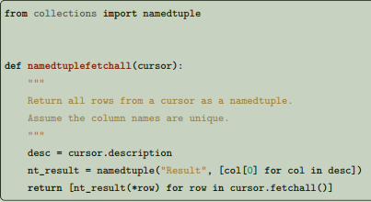
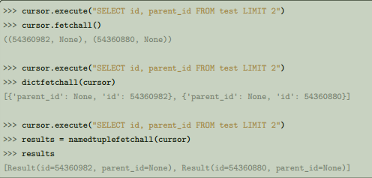

Connections and cursors
connection and cursor mostly implement the standard Python DB-API described in PEP 249 — except when it comes to transaction handling. If you’re not familiar with the Python DB-API, note that the SQL statement in cursor.execute() uses placeholders, "%s", rather than adding parameters directly within the SQL. If you use this technique, the underlying database library will automatically escape your parameters as necessary. Also note that Django expects the "%s" placeholder, not the "?" placeholder, which is used by the SQLite Python bindings. This is for the sake of consistency and sanity. Using a cursor as a context manager:
with connection.cursor() as c:
c.execute(...)
is equivalent to:
c = connection.cursor()
try:
c.execute(...)
finally:
c.close()
The dictfetchall() and namedtuplefetchall() examples assume unique column names, since a cursor cannot distinguish columns from different tables. Here is an example of the difference between the three:

Slide 11
Calling stored procedures
CursorWrapper.callproc(procname, params=None, kparams=None)
Calls a database stored procedure with the given name. A sequence (params) or dictionary (kparams) of input parameters may be provided. Most databases don’t support kparams. Of Django’s built-in backends, only Oracle supports it.
Thank you for watching 💖

